Slide 1
PICK AND PLACE ROBOT
Mentor- Dr. Swati Vaid
Presented by Paras Kushwaha, Prabhat Kumar Tiwari, Preeti Bisht, Sachin Sharma and Suraj Singh

Slide 2
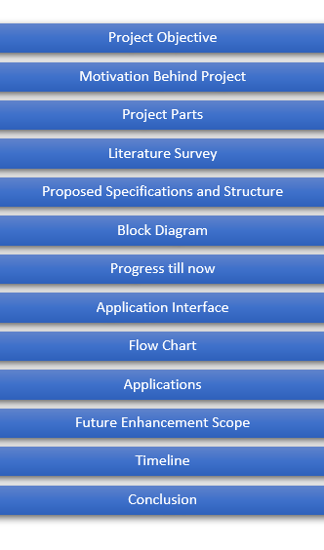
Presentation Flow

Slide 3


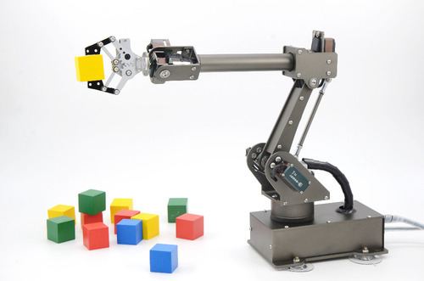
Objective
The objective of the project is to pick things from one place and place them on desired location with the help of a moving robot with an arm.

Slide 4
Motivation Behind Project?
With the thought of helping old and disabled
people who aren’t able to pick things up on their
own or have a hard time doing that.
This project can help these people picking up
things and placing them with minimal efforts.
Societal Cause
The idea emerged with the thought of helping old and disabled people.

Slide 5
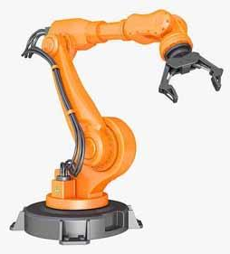
Project Parts
Project contains two types of parts-
Electronic Parts
Mechanical Parts
Mechanical arm, chassis
Note:
Electronic part is the part of the project where electronic components and circuitry work all together with the mechanical structure.

Slide 6
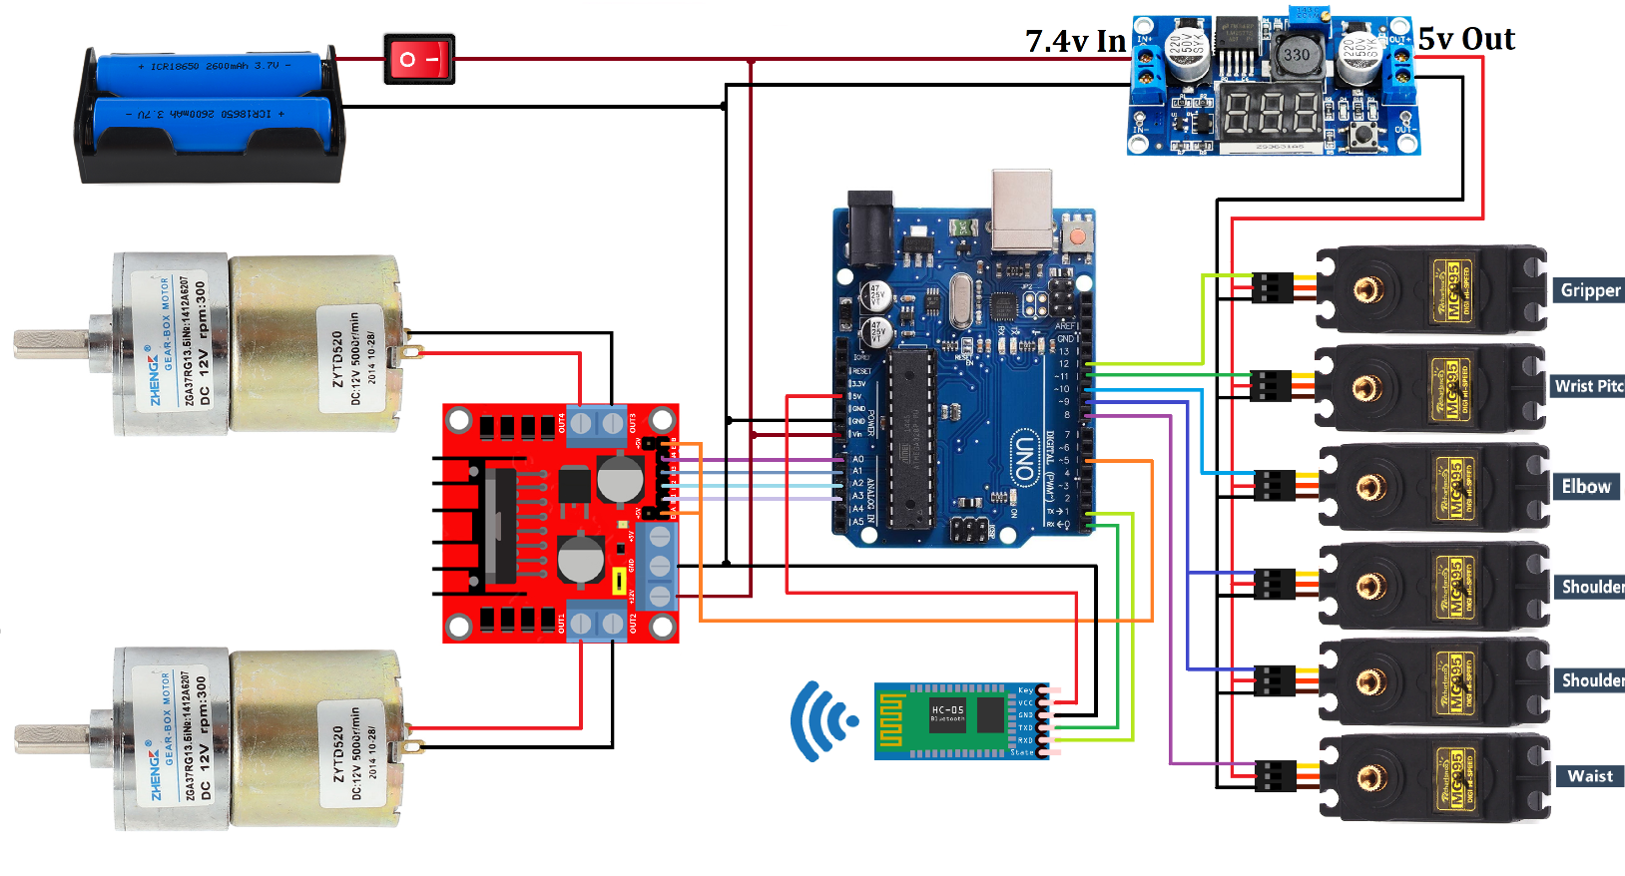
Electronic Components Used
CIRCUIT DIAGRAM
L298 Motor Driver
MG995 Servo Motor x 6
12V DC Gear Motor x 2
hc-05 Bluetooth Module
DC to DC Buck Converter

Slide 7
Literature Survey
Jorge Kazacos Winter[1] has developed android controlled robot automation. Main aim of his project was the transfer of information wirelessly between a Smartphone and the robot and developing the robot and its communication system underneath a low price and open source philosophy.
M. Selvam [2] in his paper has design to develop a robotic system which has a wireless camera attached to the surveillance. Bluetooth was implemented in his project for providing connection between robot and smart phone. Wireless night vision camera was used for providing the robot surveillance. The video which is recorded by camera is then transmitted to TV unit through radio frequency signal. He used 8051 micro-controllers for the robotic unit.

Slide 8
Arpit Sharma, Ritesh Verma, Saurabh Gupta, Sukhdeep Kaur Bhatia [3] has configured an android Smartphone which can control a robot via Bluetooth technology. The phone uses motion sensors and records the gestures sent via an android mobile phone. It also has an inbuilt accelerometer and Bluetooth module for controlling the movements of a robot.
Mohd Ashiq Kamaril Yusoffa , Reza Ezuan Saminb *, Babul Salam Kader Ibrahimc[4] has worked on wireless mobile robotic arm which can control a robotic arm with Sony PS2 wireless. They used arduino mega.
Ranjith Kumar Goud and B. Santosh Kumar [5] have invented a pick and drop robot. They wanted it to be used for diffusing a bomb remotely with safety. For the robotic arm, they used a pair of motors and another pair as the wheels of the robot for controlling the movement. Connectivity is established using Bluetooth. The micro-controller used is LPC2148. They had also attached wireless camera for remote surveThey have worked on this project mainly for industrial and military applications.

Slide 9
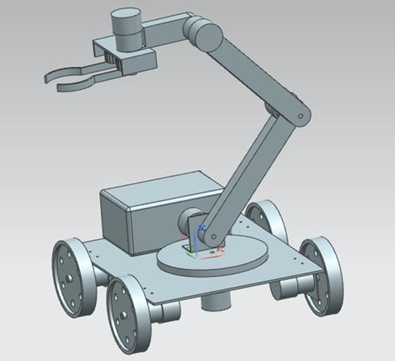
Proposed Specifications and Structure
Overview of the arm:
Degrees of freedom: 5
Payload capacity: 180gm
Joint speed (approximate): 40-60 rpm
Base spin: 180 degrees
Shoulder base spin: 160 degrees
Elbow pitch: 160 degrees
Finger opening (Max): 10cm

Slide 10
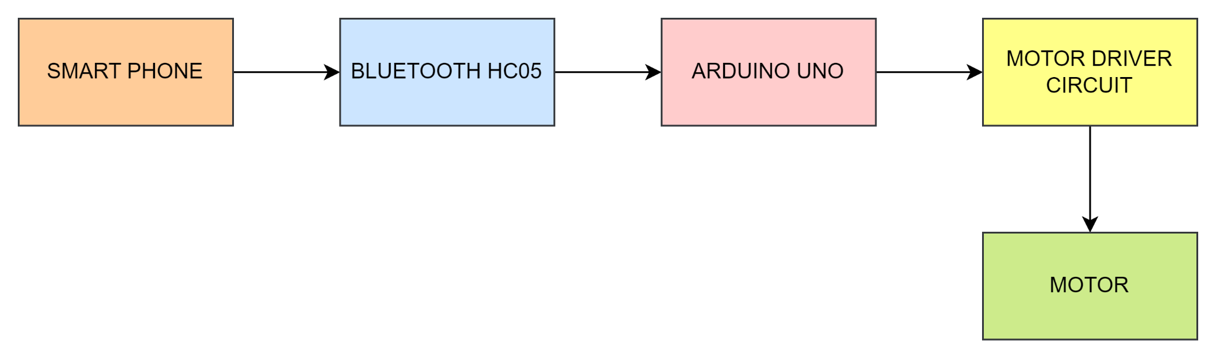
Block Diagram

Slide 11

Progress till now…
Progress | Status | Details
Initial level coding for Arduino |  | Arduino IDE
App Interface |  | Using MIT App Inventor
Hardware Components Purchased
Updates regarding the project
https://github.com/prettymess25/pickandplacerobot

Slide 12
Link for the initial code:
https://github.com/prettymess25/pickandplacerobot/blob/main/Robotic_Arm_Vehicle1.ino
Link to download the application:
https://github.com/prettymess25/pickandplacerobot/raw/main/Robotic_Arm_Vehicle%20(1).apk
Link for the design specifications:
http://ai2.appinventor.mit.edu/#5232126862426112

Slide 13
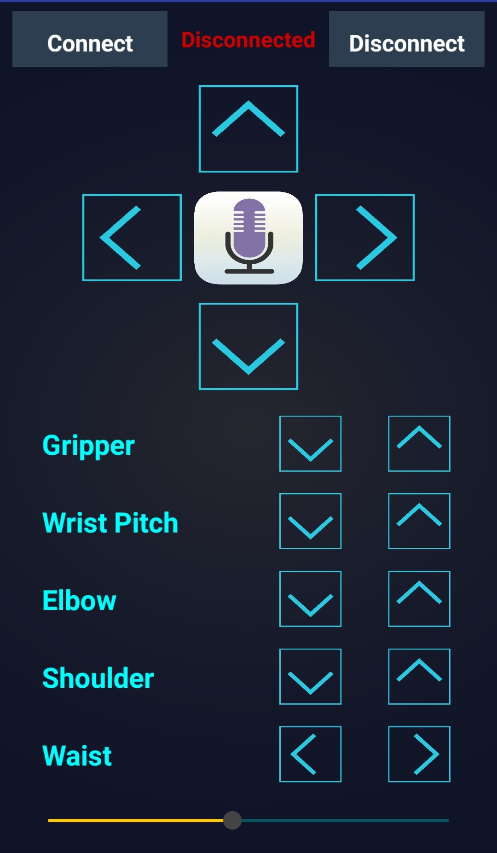
Application Interface
Features
Forward
Backward
Left
Right
Gripper
Wrist Pitch
Elbow
Shoulder
Waist

Slide 14
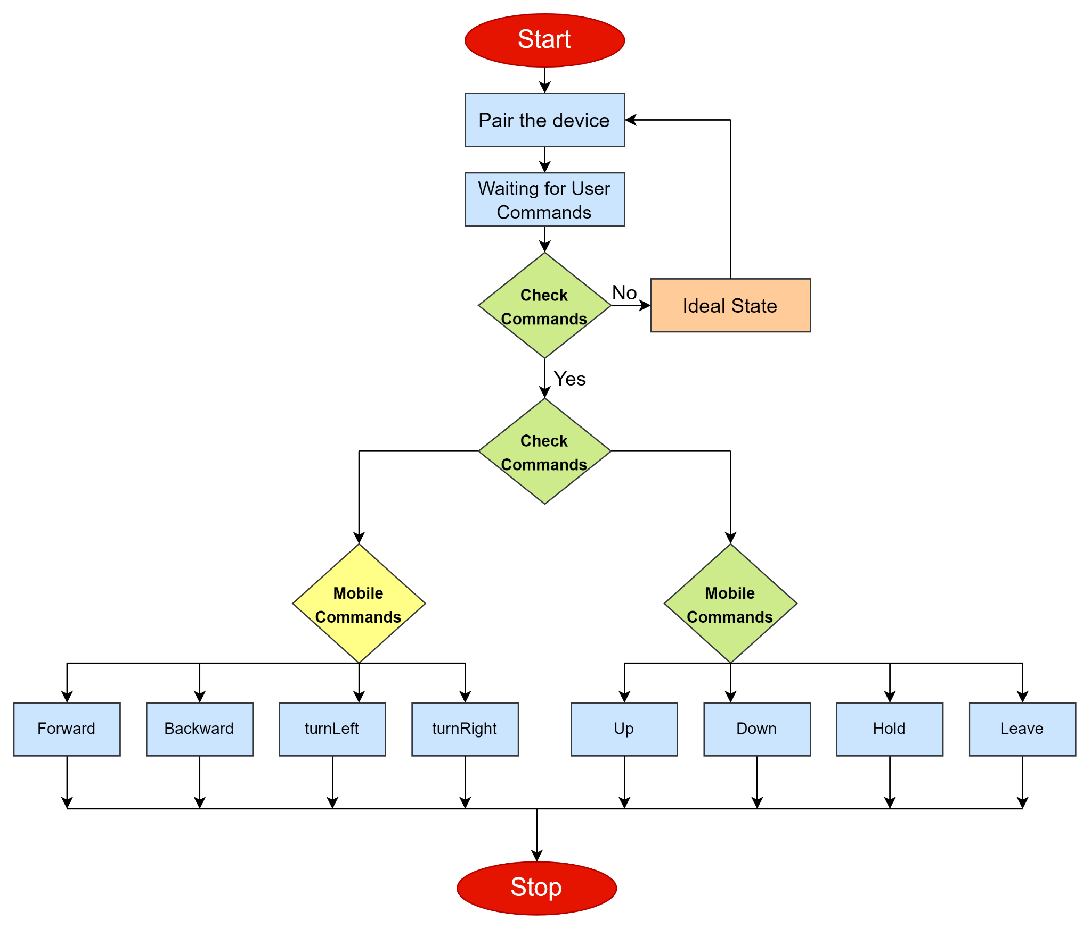
Flow Chart of App

Slide 15
Applications…
Mainly focuses on helping old and disabled people.
Can be used by common people for certain day to day activity.
Can be used in industries and offices with certain modifications according to needs.

Slide 16
Future Enhancement Scope
With high budget, the project has potential of enhancement in various ways.
Use of strong and expensive material to increase the limit of weight it can pick and hold.
More accuracy and range.
Advanced features can be introduced according to requirements.
Surface to height movement can be achieved.
Sensors for obstacle tackling and movement on it’s own.
Can introduce an AI.

Slide 17
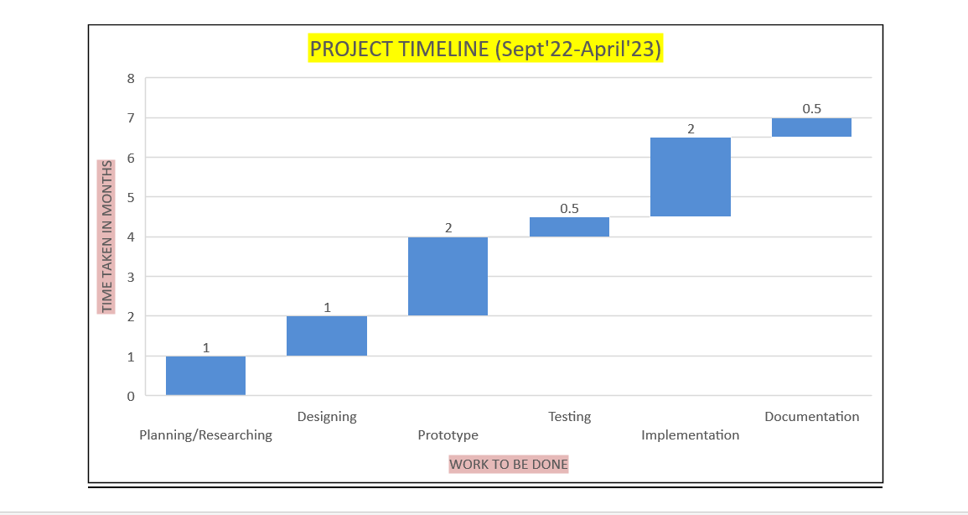
Timeline of Project

Slide 18
Conclusion
Pick and place robot can be really helpful for old and disabled people.
The cost is estimated to be around Rs. 8000 and can be reduced further with enhancements.
It can serve multiple purposes with enhancements according to needs.

Slide 19
References
Jorge Kazacos Winter “Android Controlled Mobile Robot”, Madrid, July 2013.
M. Selvam, “Smartphone-based robotic control for surveillance applications”, IJRET 2014.
Android phone controlled robot using Bluetooth by Arpit Sharma, Reetesh Verma, Saurabh Gupta, Sukhdeep Kaur Bhatia, IJEEE, Vol.7,pp-443-448, (Nov 2014).
Mohd Ashiq Kamaril Yusoff, "Wireless Mobile Robotic Arm ",2012,International Symposium on Robotics and Intelligent Sensors 2012 (IRIS 2012).
Ranjit, B.Santhos, "Android Based Robot Implementation For Pick and Retain of Objects", 2014, International Journal of Engineering Trends and Technology (IJETT)-Volume 16 Number 3-Oct 2014.

